Slide 1

WELCOME
Shrewd Investor
Course
Introduction
to
Stock Markets

Slide 2
Fundamental Analysis
Ratio Analysis
Screener.in

Slide 3
1. Market Capitalization
Or MarCap
Current valuation of company
No of shares * CMP
MarCap in Crore | Classification
< 5000 | Small Cap
5000 – 20000 | Medium Cap
> 20000 | Large Cap

Slide 4
2. Price/Earning (PE)
Valuation = Cheap or Expensive
PE = Current Price
Earing Per Share
Stock PE v. Industry PE

Slide 5
3. Return on Capital Employed (ROCE)
Efficiency
ROCE = Earings Before Interest & Tax (EBIT)
Capital Employed

Slide 6
4. Debt/Equity (D/E)
How much loan or debt company has?
DE = Total Debt
Shareholder’s Equity

Slide 7
5. Interest Coverage Ratio
Can company pay interest on its loan?
EBIT
Interest Expense

Slide 8
6. Dividend Yield
Dividend % on stock price
Annual Dividend
Share Price

Slide 9
7. Sales YoY & QoQ
YoY
March 19 | March 20 | March 21 | March22
100 | 110 | 140 | 200
Growth | 10% | 21.42% | 30%
QoQ
June 19 | June 20 | June 21 | June22
25 | 30 | 40 | 60
Growth | 16% | 25% | 33.33%

Slide 10
8. Operating Profit & OPM
 | ABC | XYZ
Sales | 100 | 100
Operating Profit | 10 | 20
OPM% | 10% | 20%

Slide 11
9. Earnings Per Share (EPS)
EPS = Net Income
No. Of Shares

Slide 12
10. Cash Flow:
Will save you from fraud companies!
Is company receiving cash from operation?

Slide 13
11. Share Holding Pattern:
Promoter & Institutional Holding
Stock | ABC | XYZ
Promoter | 60 | 30
FII | 10 | 2
DII | 10 | 1
Public | 20 | 67
Total | 100% | 100%

Slide 14
Recap:
Ratio | Preferred | Range
PE | Low | < 30
ROCE | High | > 20%
D/E | Low | < 1
Interest Coverage Ratio | High | > 2
Sales Growth | High | > 10%
OPM | High | > 15%
EPS Growth | High | > 10%
Promoter, FII & DII shareholding | High

Slide 15
Learn to use Screener.in

Slide 16


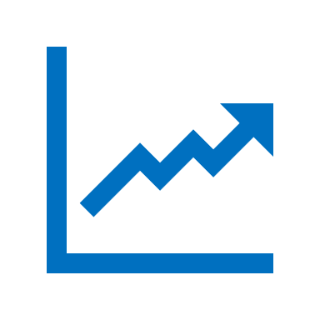
Shrewd Investor
Fundamental Analysis
Ratio Analysis
Stock Selection
Investment Strategies
Risk Management
Swing Trading
Sunday 10 AM
Duration 6-8 hours
Zoom or Skype

Slide 17
#06283D
#F4F4F2
#FEB202
#FF8701

